Slide 1

Engineering Economics and Financial Management
INTRODUCTION

Slide 2
In this course
Introduction to Engineering economics
Time Value of Money
Economic Evaluation of alternatives
Replacement analysis
Depreciation accounting
Break-even analysis
Ratio analysis

Slide 3
Text books
Contemporary engineering economics
By Chan S Park
Engineering Economics
By James L Riggs
Engineering economic Analysis
By Donald G Newnan
Engineering economy
By Thuesen and Fabrycky
** Students are required to bring Interest factor tables and question sheets to every class.

Slide 4
Course outcomes
CO1: Find the worth of money at various points of time.
(Topics covered- TVM, Nominal and effective interest rates)
CO2: Recommend the best alternative to satisfy the economic requirements of a given project.
(Topics covered- Evaluation of alternatives, BEA)
CO3: Recommend the Replacement of an existing asset based on standard replacement analysis techniques.
(Topics covered- Outsider’s/Insider’s point of view approach, Economic service life)
CO4: Calculate the worth of assets using various Depreciation techniques.
(Topics covered: Straight line method, Declining balance and Double declining balance methods)
CO5: Calculate the Financial ratios from the balance sheet of organizations.
(Topics covered- Ratio analysis)

Slide 5
In today’s class
Course outcomes
Understand the role of engineers in business
Engineering economic decisions
Micro and Macro Economics

Slide 6
As engineers, what is our job?
Engineering :
A profession in which a knowledge of the mathematical and natural sciences is applied with judgment to develop ways to utilize economically the materials and forces of nature for the benefit of mankind.
-ABET

Slide 7
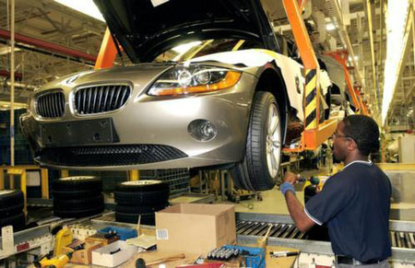

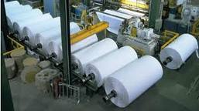
How engineering relates to utility
The purpose of engineering effort is to determine
how physical factors may be altered to create the
most utility for the least cost.

Slide 8
Why engineering economics?
Engineers are confronted with two important interconnected environments, the physical and the economic.
The usual function of engineering is to manipulate the elements of one environment , the physical , to create value in the second environment, the economic.

Slide 9
Macro or micro economics?

Slide 10
MACROECONOMICS
Players in an economic system:
Household/ citizens
Firms/ Businesses/ Corporates
Financial system/ Central banks
Government
Macroeconomics examines the aggregate behavior of the economy (i.e. how the actions of all the players in the economic system interact to produce a particular level of economic performance as a whole).

Slide 11
MACRO ECONOMICS
It focuses on issues such as
GDP
Unemployment
Inflation
Deficit
Economic policies
Economic growth and other related issues, which affect the economy as a whole.
These concepts are not simple & direct.

Slide 12
MICROECONOMICS
Microeconomics is the study of individuals, households and firms' behavior in decision making and allocation of resources.

Slide 13

Decision Making:
The Decision-Making Process
Understand the Problem
Identify the decision criterion
Allocating Weights to the Criteria
Developing Alternatives
Analyzing alternatives
Select the “best” alternative
Implementing
Monitoring

Slide 14
Common types of Engineering economic decisions
Equipment or process selection
Equipment replacement
New product or product expansion
Improvement in Service and Quality
(Source: Chan S Park, Contemporary Engineering Economics)

Slide 15
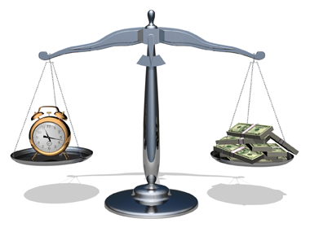
Time value of money

Slide 16
Interest and Interest rate
2 view points on interest
Meaning of Time Value of Money
Cash Flow Diagrams (CFDs)

Slide 17
INTEREST AND INTEREST RATE
Interest:
is the rental amount charged by the financial institutions for the use of money.
Interest rate:
is the rate at which interest is paid by a borrower for the use of money that they borrow from a lender.
Generally, Interest rates are stated on a per year basis.

Slide 18

Factors influencing the interest rate
Opportunity cost, that is, compensation for being deprived of electing other alternatives.
Probability that the borrower will repay the loan.
Expenses incurred in investigating the borrower, transferring funds or collecting it back.
Probability that the interest rate may change due to inflationary effects.

Slide 19

Why does money have time value?
Money has a time value because it can earn more money over time (earning power).
Money has a time value because its purchasing power changes over time (inflation).
Time value of money is measured in terms of interest rate.

Slide 20
The relationship between _____ and _______
is the concept of Time Value of Money (TVM)

Slide 21
The relationship between time and interest rate
is the concept of Time Value of Money (TVM)

Slide 22
Simple Interest
P = Principal amount
i = Interest rate
N = Number of interest periods
Example:
P = $1,000
i = 8%
N = 3 years
End of Year | Beginning Balance | Interest earned | Ending Balance
0 |  |  | $1,000
1 | $1,000 | $80 | $1,080
2 | $1,080 | $80 | $1,160
3 | $1,160 | $80 | $1,240

Slide 23
Simple Interest Formula

Slide 24
Compound Interest
P = Present (Principal) amount
i = Interest rate
n = Number of interest periods
Example:
P = $1,000
i = 8%
n = 3 years
End of Year | Beginning Balance | Interest earned | Ending Balance
0 |  |  | $1,000
1 | $1,000 | $80 | $1,080
2 | $1,080 | $86.40 | $1,166.40
3 | $1,166.40 | $93.31 | $1,259.71

Slide 25
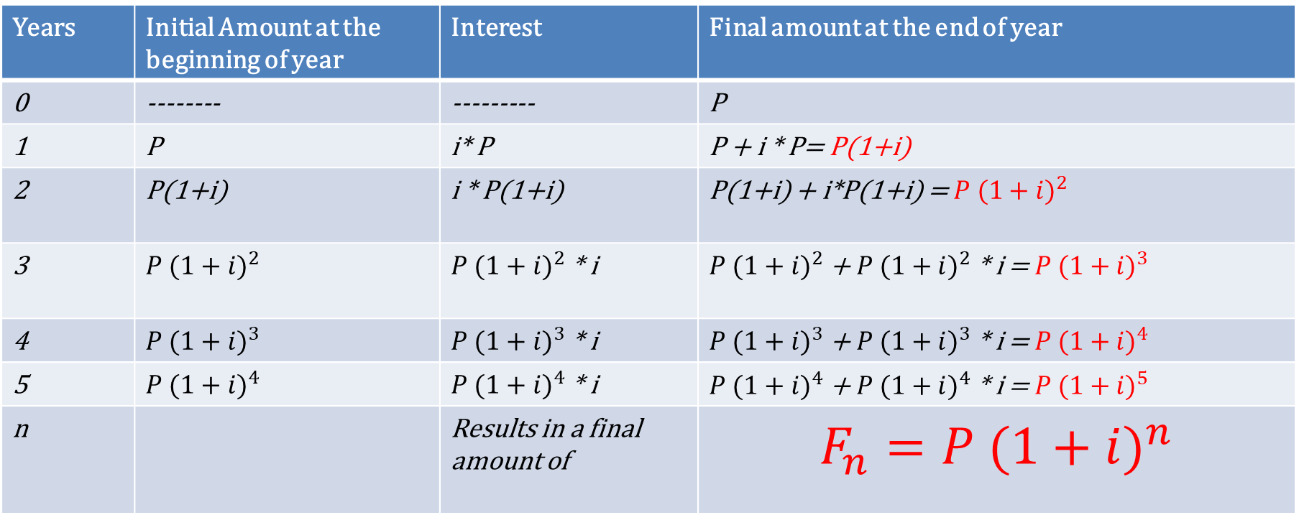
Compound Interest
Years | Initial Amount at the beginning of year | Interest | Final amount at the end of year
0 | -------- | --------- | P
1 | P | i* P | P + i * P= P(1+i)
2 | P(1+i) | i * P(1+i) | P(1+i) + i*P(1+i) = $P {(1+i)}^{2}$
3 | $$P {(1+i)}^{2}$$ | $P {(1+i)}^{2}$ * i | $P {(1+i)}^{2}$ + $P {(1+i)}^{2}$ * i = $P {(1+i)}^{3}$
4 | $$P {(1+i)}^{3}$$ | $P {(1+i)}^{3}$ * i | $P {(1+i)}^{3}$ + $P {(1+i)}^{3}$ * i = $P {(1+i)}^{4}$
5 | $$P {(1+i)}^{4}$$ | $P {(1+i)}^{4}$ * i | $P {(1+i)}^{4}$ + $P {(1+i)}^{4}$ * i = $P {(1+i)}^{5}$
n |  | Results in a final amount of | $$F_{n}=P {(1+i)}^{n}$$

Slide 26
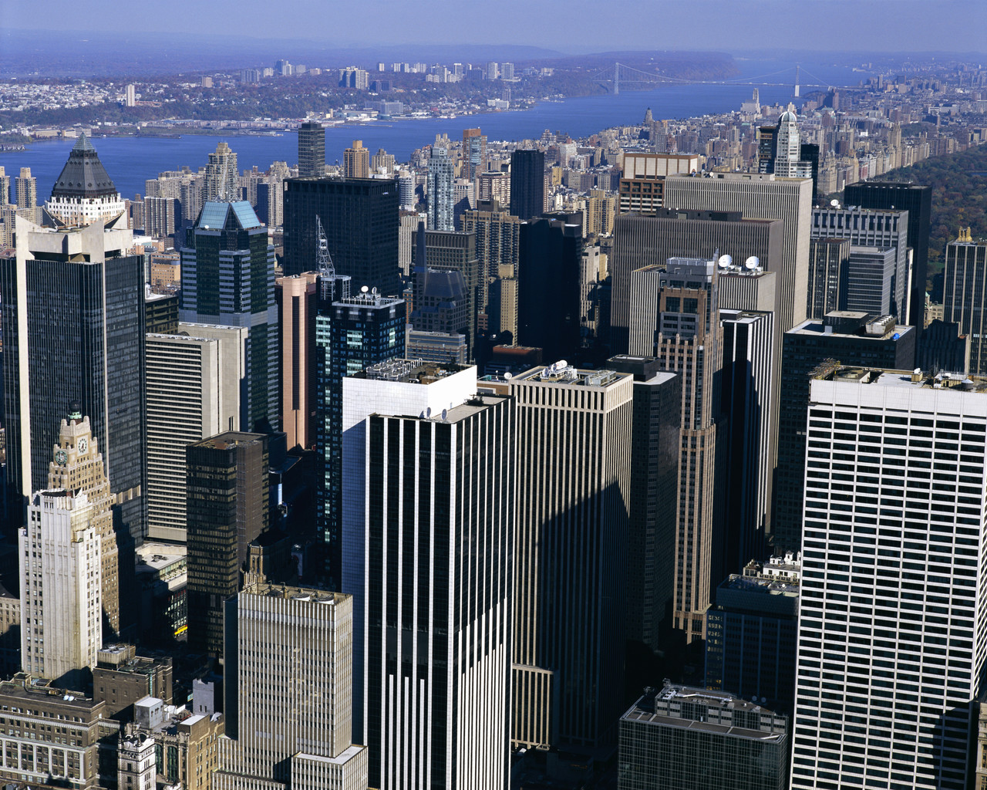
Example:
In 1626, Peter Minuit of DWI Co., paid $24 to purchase Manhattan Island in NY from the Indians. In retrospect, if Minuit had invested the $ 24 in a savings account that earned 8% interest, how much it would be worth in 2023?Calculate using both SI and CI.

Slide 27
Using Simple interest ;
$786.24
Using Compound interest;
$446 Trillion
P= $24
i=8% =0.08
n= 2023-1626=397 years

Slide 28
Cash Flow Diagram
Cash flow diagrams are the simple diagrammatic representation of income (receipts) and expenses (disbursements, outlay).
Generally before constructing the diagram it is very common to define the time frame over which cash flow occurs.
The time frame thus forms the horizontal axis which is divided into time periods, often in years.
0
i%
10

Slide 29
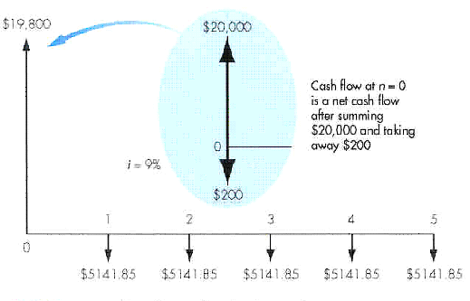
Cash Flow Diagram (CFD)

Slide 30
End-of-Period Convention
Interest Period
0
1
Beginning of
Interest period
End of interest
period
0
1

Slide 31
Cash Flow Diagram
(a) Borrower’s viewpoint
Loan in Rs
+
1
2
3
time
-
0
10
Payment (expenditures)
Rs
Rs
Rs
(b) Lender’s viewpoint
Rs
Rs
Rs
Payment (receipt)
+
0
time
-
i%
10
Loan in Rs

Slide 32
Cash flow patterns
Single payment
Equal payment/ Uniform series
Linear gradient series

Slide 33
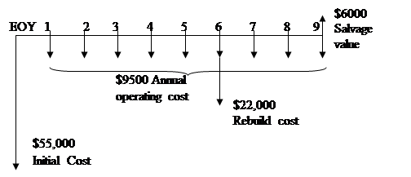
Example : Cash Flow diagram (CFD)
Revenue
$ 10,000
$ 25,000

Slide 34
Ex 1: Draw CFDs
If $1,500 is invested now, $1,800 two years from now, and $2,000 four years from now at an interest rate of 6% compounded annually, what will be the total amount in 15 years?
?
И
15 Years
0
1
2
3
4
$1500
$1800
$2000

Slide 35
Ex 2: Draw CFDs
A student is buying an automobile that costs $12,000 and she will borrow the money from a bank, and pay the loan off in five equal annual instalments at 15% interest rate. Prepare a cash flow diagram to represent this situation.
$12000
15%
0
5 years
1
2
3
4
A
A
A
A
A

Slide 36
Ex 3: Draw CFDs
Suppose you make an annual contribution of $3000 to your savings account at the end of each year for 10 years. If the account earns 7% interest annually, how much can be withdrawn at the end of 10 years?
Suppose the ten deposits were made at the beginning of each period, what is the balance at the end of period 10?

Slide 37

a)
$F_{n}$ =?
7%
И
0
1
2
3
4
5
10 years
1
3000
3000
3000
3000
3000
3000

Slide 38

b)
$F_{n}$ =?
И
0
1
2
3
4
9
10 years
1
3000
3000
3000
3000
3000
3000

Slide 39
Ex 4: Draw CFDs
Suppose that you have a savings plan covering the next ten years, according to which you put aside $600 today, $800 at the end of every year for the next five years, and $2000 at the end of each year for the remaining five years. As part of this plan, you expect to withdraw $100 at the end of year 2 and increase the amount by $20 every year for the next 4 years, and an amount A at the end of every year thereafter till the 10th year. Draw the cash flow diagram.

